Slide 1

Riding
The Waves
Strategies for success
In Uncertain Times
Dr. Joe Parent

Slide 2
CONFIDENCE
FALSE
CONDITIONAL
UNCONDITIONAL

Slide 3
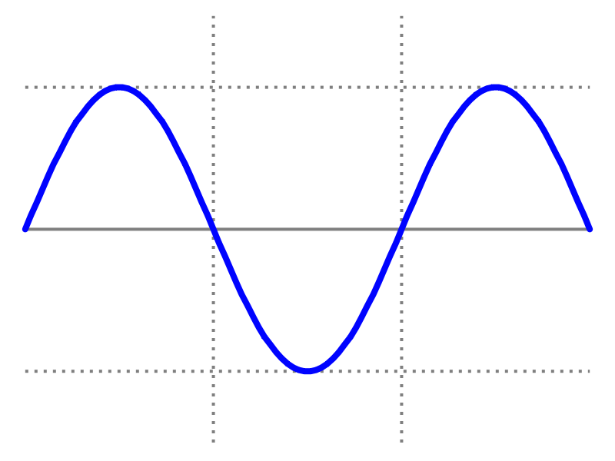
How Things Go

Slide 4
How Things Go Wrong

Slide 5
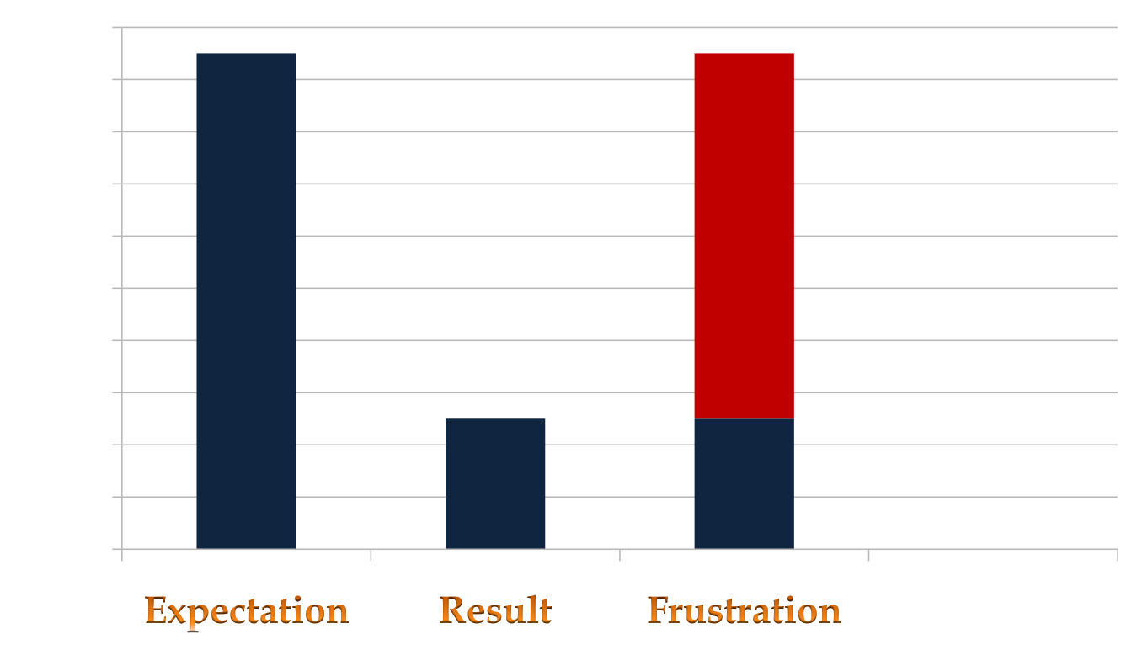
E – R = F

Slide 6
A Different Perspective
Objective vs. Emotional
Big vs. Small
Positive vs. Negative

Slide 7
The PAR Approach™
Preparation
Action
Response to Results

Slide 8
FOUR KINDS OF YES AND NO
YES YES
NO NO
NO YES
YES NO (Uh Oh!)

Slide 9
The NINJA System for
Changing Habits
Necessary
Intention
Non-
Judgmental
Awareness

Slide 10
Living a RICH Life
Treat yourself and others with RESPECT
Be recognized as a person of INTEGRITY
Trust in your unconditional CONFIDENCE
Fulfill all commitments with HONOR

